Slide 1
Matthew 7:13-23
Rod Thom

Slide 2
Matthew 7:13-23 (NIV)
The Narrow and Wide Gates
13 “Enter through the narrow gate. For wide is the gate and broad is the road that leads to destruction, and many enter through it. 14 But small is the gate and narrow the road that leads to life, and only a few find it.

Slide 3
Matthew 7:13-23 (NIV)
True and False Prophets
15 “Watch out for false prophets. They come to you in sheep’s clothing, but inwardly they are ferocious wolves. 16 By their fruit you will recognize them. Do people pick grapes from thornbushes, or figs from thistles? 17 Likewise, every good tree bears good fruit, but a bad tree bears bad fruit.

Slide 4
Matthew 7:13-23 (NIV)
18 A good tree cannot bear bad fruit, and a bad tree cannot bear good fruit. 19 Every tree that does not bear good fruit is cut down and thrown into the fire. 20 Thus, by their fruit you will recognize them.

Slide 5
Matthew 7:13-23 (NIV)
True and False Disciples
21 “Not everyone who says to me, ‘Lord, Lord,’ will enter the kingdom of heaven, but only the one who does the will of my Father who is in heaven. 22 Many will say to me on that day, ‘Lord, Lord, did we not prophesy in your name and in your name drive out demons and in your name perform many miracles?’ 23 Then I will tell them plainly, ‘I never knew you. Away from me, you evildoers!’

Slide 6
The Power of a Decision
Decisions Determine Destiny

Slide 7
1. 2 WAYS
The Narrow and Wide Gates
13 “Enter through the narrow gate. For wide is the gate and broad is the road that leads to destruction, and many enter through it. 14 But small is the gate and narrow the road that leads to life, and only a few find it.

Slide 8
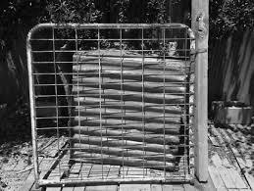
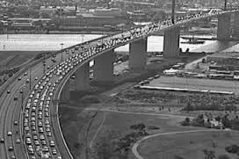
1. 2 WAYS
John 14:6 Jesus answered, “I am the way and the truth and the life. No one comes to the Father except through me.

Slide 9
2. 2 TREES
True and False Prophets
15 “Watch out for false prophets. They come to you in sheep’s clothing, but inwardly they are ferocious wolves. 16 By their fruit you will recognize them. Do people pick grapes from thornbushes, or figs from thistles? 17 Likewise, every good tree bears good fruit, but a bad tree bears bad fruit. 18 A good tree cannot bear bad fruit, and a bad tree cannot bear good fruit. 19 Every tree that does not bear good fruit is cut down and thrown into the fire. 20 Thus, by their fruit you will recognize them.

Slide 10
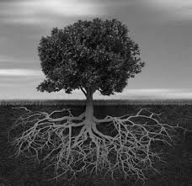
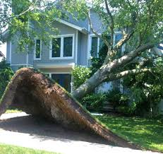
2. 2 TREES
GOOD Godly CONDUCT + GOOD Godly CHARACTER = GOOD FRUIT

Slide 11
3. 2 Claims
True and False Disciples
21 “Not everyone who says to me, ‘Lord, Lord,’ will enter the kingdom of heaven, but only the one who does the will of my Father who is in heaven. 22 Many will say to me on that day, ‘Lord, Lord, did we not prophesy in your name and in your name drive out demons and in your name perform many miracles?’ 23 Then I will tell them plainly, ‘I never knew you. Away from me, you evildoers!’

Slide 12
Space to Reflect

